Slide 1
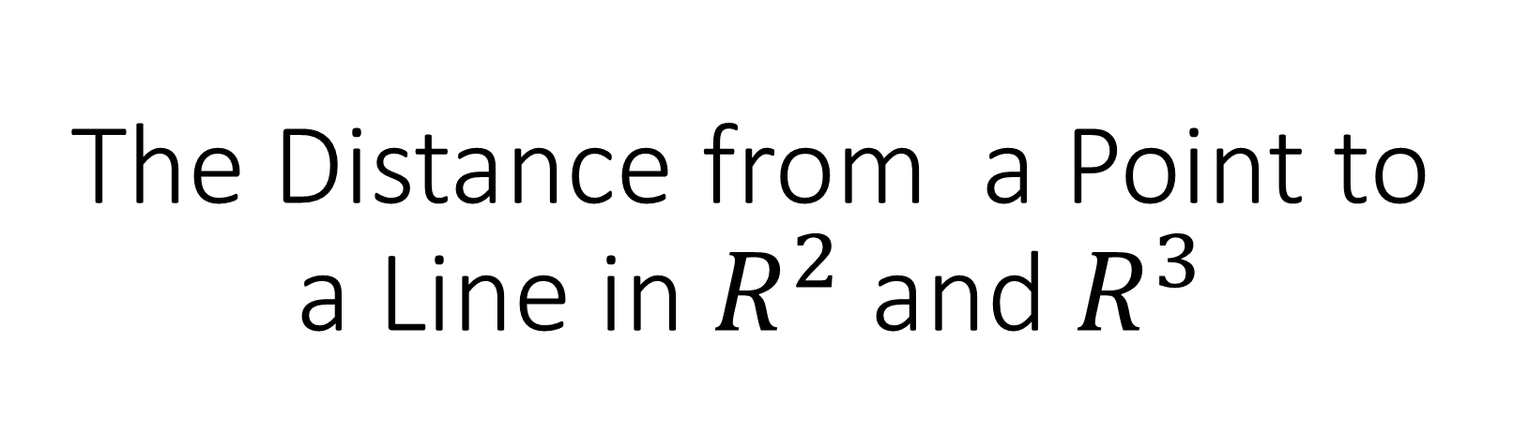
The Distance from a Point to a Line in $R^{2}$ and $R^{3}$

Slide 2
When we discuss the distance from a point to a line, we are referring to a perpendicular distance. In other words, the distance d refers to the distance expressed in the first diagram, not any of the other diagrams.
A .
B .
C .
D .

Slide 3
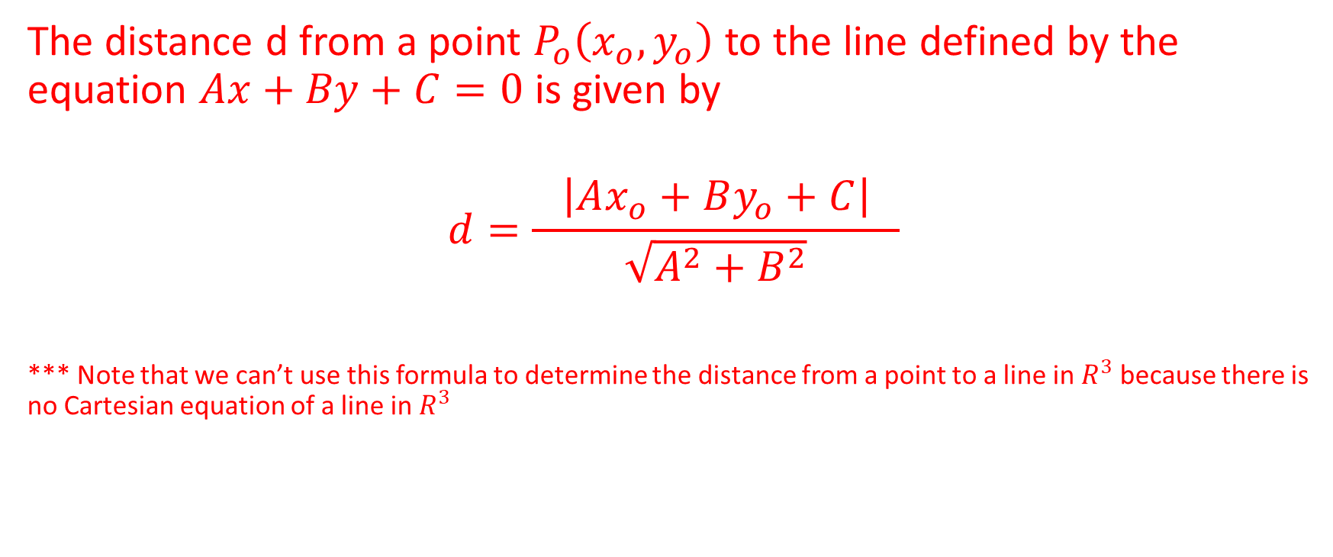
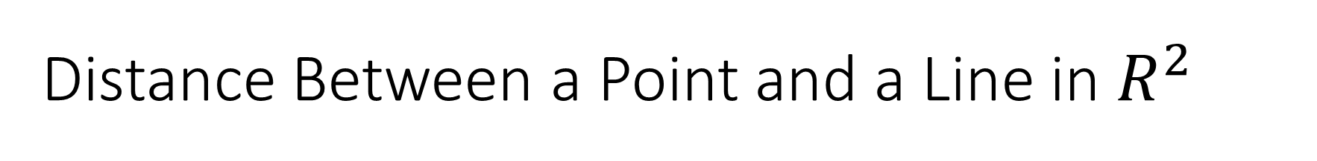
Distance Between a Point and a Line in $R^{2}$
The distance d from a point $P_{o}\left(x_{o},y_{o}\right)$ to the line defined by the equation $Ax+By+C=0$ is given by
$$d=\frac{ \left|Ax_{o}+By_{o}+C\right| }{\sqrt{A^{2}+B^{2}}}$$
*** Note that we can’t use this formula to determine the distance from a point to a line in $R^{3}$ because there is no Cartesian equation of a line in $R^{3}$

Slide 4
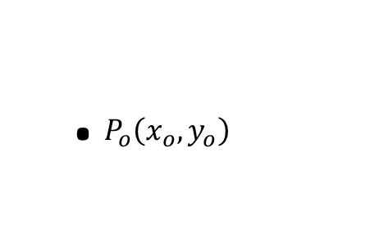
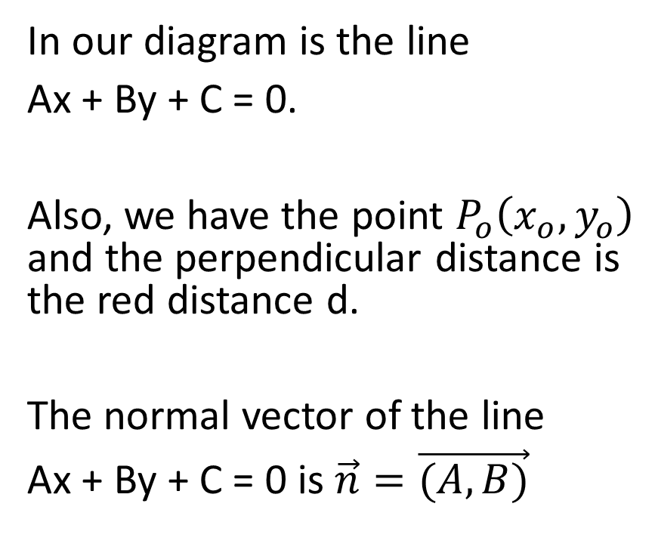


Let’s Justify the Formula We Just Learned
In our diagram is the line
Ax + By + C = 0.
Also, we have the point $P_{o}\left(x_{o},y_{o}\right)$ and the perpendicular distance is the red distance d.
The normal vector of the line
Ax + By + C = 0 is $\vec{n}=\vec{(A,B)}$
.
. $P_{o}\left(x_{o},y_{o}\right)$
Ax + By + C = 0
$$\vec{n}=\vec{(A,B)}$$

Slide 5

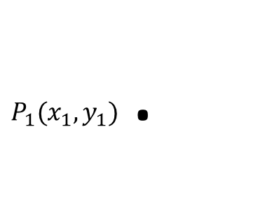
Next we consider the point $P_{1}\left(x_{1},y_{1}\right)$ which is on the line
Ax + By + C = 0.
.
. $P_{o}\left(x_{o},y_{o}\right)$
$P_{1}(x_{1},y_{1})$ .
Ax + By + C = 0
$$\vec{n}=\vec{(A,B)}$$

Slide 6
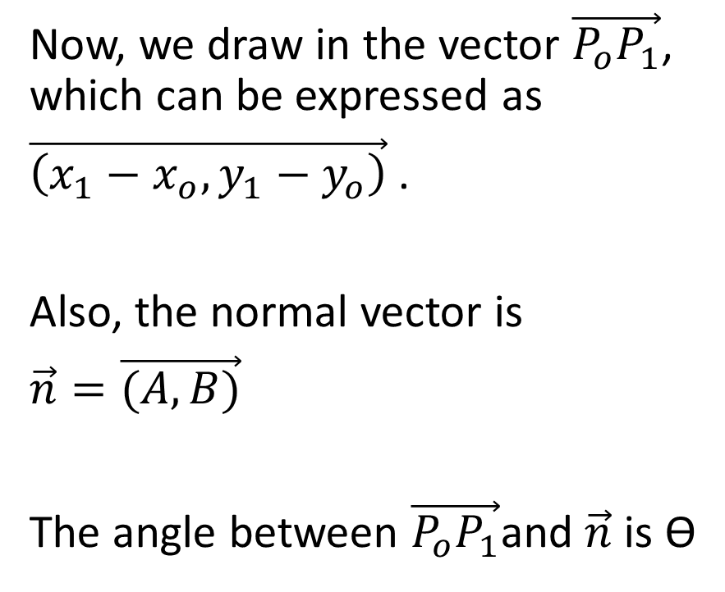
Now, we draw in the vector $\vec{P_{o}P_{1}}$, which can be expressed as
$\vec{\left(x_{1}−x_{o},y_{1}−y_{o}\right)}$ .
Also, the normal vector is
$\vec{n}=\vec{(A,B)}$
The angle between $\vec{P_{o}P_{1}}$and $\vec{n}$ is Ɵ
.
. $P_{o}\left(x_{o},y_{o}\right)$
$P_{1}(x_{1},y_{1})$ .
Ax + By + C = 0
$$\vec{n}=\vec{(A,B)}$$

Slide 7
Now, indicate the point R
.
. $P_{o}\left(x_{o},y_{o}\right)$
$P_{1}(x_{1},y_{1})$ .
.
R
Ax + By + C = 0
$$\vec{n}=\vec{(A,B)}$$

Slide 8
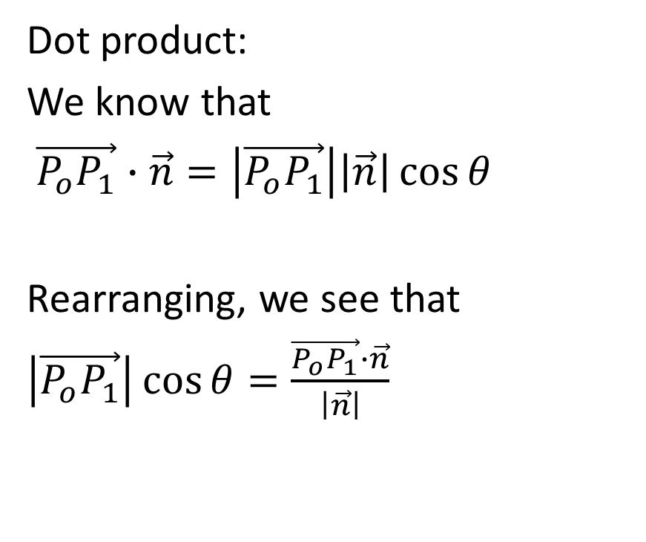
Dot product:
We know that
$\vec{P_{o}P_{1}}∙\vec{n}=\left|\vec{P_{o}P_{1}}\right|\left|\vec{n}\right|\cos{θ}$
Rearranging, we see that
$\left|\vec{P_{o}P_{1}}\right|\cos{θ=\frac{\vec{P_{o}P_{1}}∙\vec{n}}{\left|\vec{n}\right|}}$
.
. $P_{o}\left(x_{o},y_{o}\right)$
$P_{1}(x_{1},y_{1})$ .
.
R
Ax + By + C = 0
$$\vec{n}=\vec{(A,B)}$$

Slide 9

$\left|\vec{P_{o}P_{1}}\right|\cos{θ=\frac{\vec{P_{o}P_{1}}∙\vec{n}}{\left|\vec{n}\right|}}$
.
. $P_{o}\left(x_{o},y_{o}\right)$
$P_{1}(x_{1},y_{1})$ .
.
R
Ax + By + C = 0
$$\vec{n}=\vec{(A,B)}$$

Slide 10
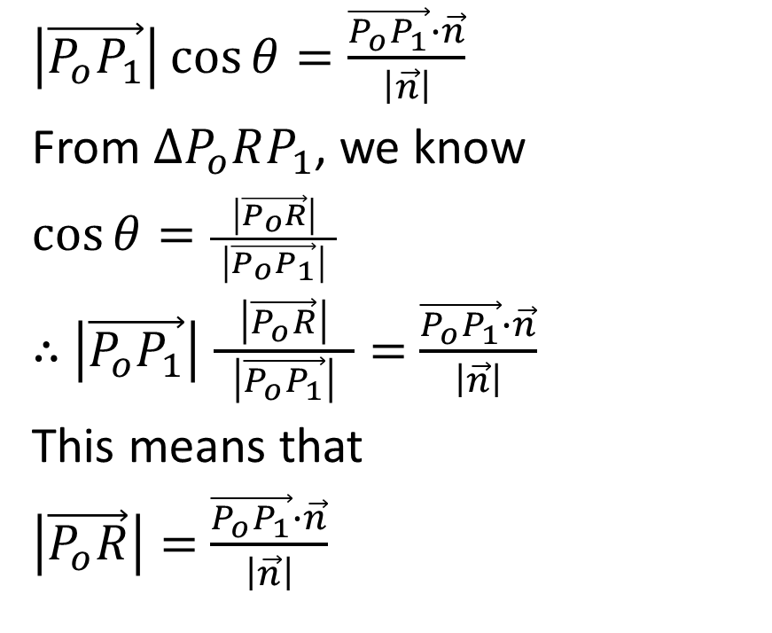
$\left|\vec{P_{o}P_{1}}\right|\cos{θ=\frac{\vec{P_{o}P_{1}}∙\vec{n}}{\left|\vec{n}\right|}}$
From $∆P_{o}RP_{1}$, we know
$\cos{θ}=\frac{ \left|\vec{P_{o}R}\right| }{\left|\vec{P_{o}P_{1}}\right|}$
$∴$ $\left|\vec{P_{o}P_{1}}\right|$ $\frac{ \left|\vec{P_{o}R}\right| }{\left|\vec{P_{o}P_{1}}\right|}=$ $\frac{\vec{P_{o}P_{1}}∙\vec{n}}{\left|\vec{n}\right|}$
This means that
$\left|\vec{P_{o}R}\right|=$ $\frac{\vec{P_{o}P_{1}}∙\vec{n}}{\left|\vec{n}\right|}$
.
. $P_{o}\left(x_{o},y_{o}\right)$
$P_{1}(x_{1},y_{1})$ .
.
R
Ax + By + C = 0
$$\vec{n}=\vec{(A,B)}$$

Slide 11

$\left|\vec{P_{o}P_{1}}\right|\cos{θ=\frac{\vec{P_{o}P_{1}}∙\vec{n}}{\left|\vec{n}\right|}}$
From $∆P_{o}RP_{1}$, we know
$\cos{θ}=\frac{ \left|\vec{P_{o}R}\right| }{\left|\vec{P_{o}P_{1}}\right|}$
$∴$ $\left|\vec{P_{o}P_{1}}\right|$ $\frac{ \left|\vec{P_{o}R}\right| }{\left|\vec{P_{o}P_{1}}\right|}=$ $\frac{\vec{P_{o}P_{1}}∙\vec{n}}{\left|\vec{n}\right|}$
This means that
$\left|\vec{P_{o}R}\right|=$ $\frac{\vec{P_{o}P_{1}}∙\vec{n}}{\left|\vec{n}\right|}$
.
. $P_{o}\left(x_{o},y_{o}\right)$
$P_{1}(x_{1},y_{1})$ .
.
R
$$d=\left|\vec{P_{o}R}\right|$$
Ax + By + C = 0
$$\vec{n}=\vec{(A,B)}$$

Slide 12

$∴d=$ $\frac{\vec{P_{o}P_{1}}∙\vec{n}}{\left|\vec{n}\right|}$
.
. $P_{o}\left(x_{o},y_{o}\right)$
$P_{1}(x_{1},y_{1})$ .
.
R
Ax + By + C = 0
$$\vec{n}=\vec{(A,B)}$$

Slide 13
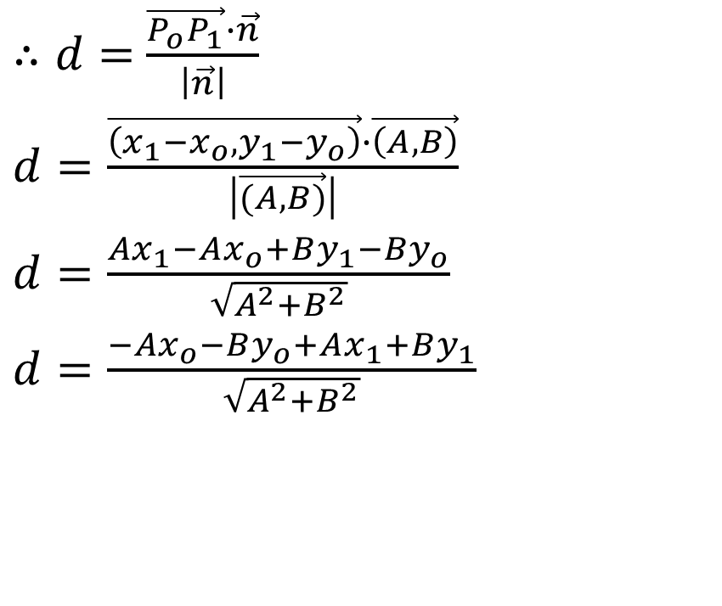
$∴d=$ $\frac{\vec{P_{o}P_{1}}∙\vec{n}}{\left|\vec{n}\right|}$
$d=\frac{\vec{\left(x_{1}−x_{o},y_{1}−y_{o}\right)}∙\vec{\left(A,B\right)}}{\left|\vec{(A,B)}\right|}$
$d=\frac{Ax_{1}−Ax_{o}+By_{1}−By_{o}}{\sqrt{A^{2}+B^{2}}}$
$d=\frac{−Ax_{o}−By_{o}+Ax_{1}+By_{1}}{\sqrt{A^{2}+B^{2}}}$
.
. $P_{o}\left(x_{o},y_{o}\right)$
$P_{1}(x_{1},y_{1})$ .
.
R
Ax + By + C = 0
$$\vec{n}=\vec{(A,B)}$$

Slide 14

$d=\frac{−Ax_{o}−By_{o}+Ax_{1}+By_{1}}{\sqrt{A^{2}+B^{2}}}$
.
. $P_{o}\left(x_{o},y_{o}\right)$
$P_{1}(x_{1},y_{1})$ .
.
R
Ax + By + C = 0
$$\vec{n}=\vec{(A,B)}$$

Slide 15
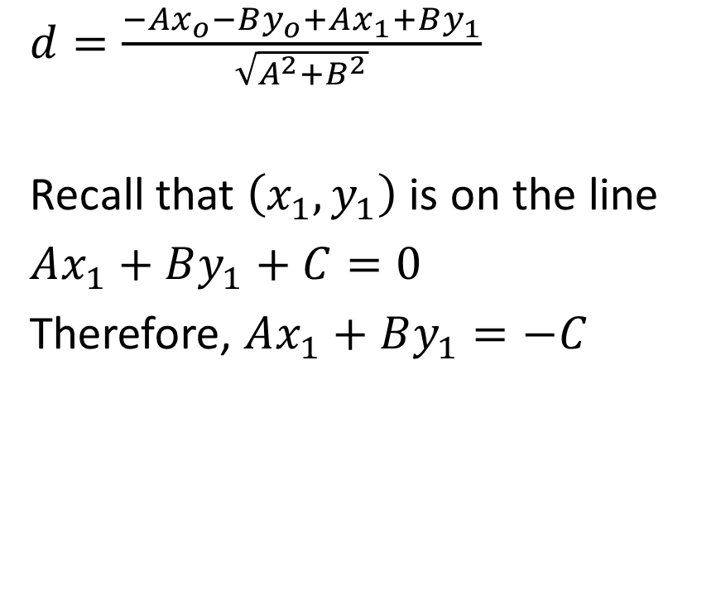
$d=\frac{−Ax_{o}−By_{o}+Ax_{1}+By_{1}}{\sqrt{A^{2}+B^{2}}}$
Recall that $\left(x_{1},y_{1}\right)$ is on the line
$Ax_{1}+By_{1}+C=0$
Therefore, $Ax_{1}+By_{1}=−C$
.
. $P_{o}\left(x_{o},y_{o}\right)$
$P_{1}(x_{1},y_{1})$ .
.
R
Ax + By + C = 0
$$\vec{n}=\vec{(A,B)}$$

Slide 16
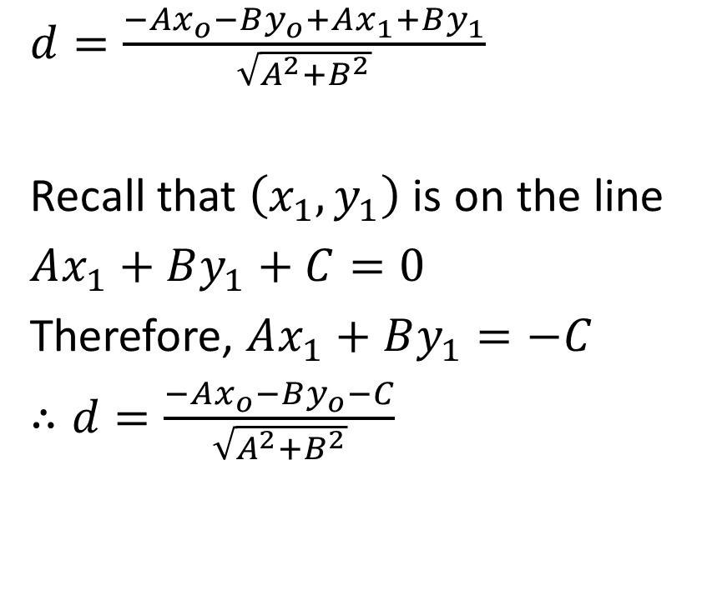
$d=\frac{−Ax_{o}−By_{o}+Ax_{1}+By_{1}}{\sqrt{A^{2}+B^{2}}}$
Recall that $\left(x_{1},y_{1}\right)$ is on the line
$Ax_{1}+By_{1}+C=0$
Therefore, $Ax_{1}+By_{1}=−C$
$∴d=\frac{−Ax_{o}−By_{o}−C}{\sqrt{A^{2}+B^{2}}}$
.
. $P_{o}\left(x_{o},y_{o}\right)$
$P_{1}(x_{1},y_{1})$ .
.
R
Ax + By + C = 0
$$\vec{n}=\vec{(A,B)}$$

Slide 17

$d=\frac{−Ax_{o}−By_{o}−C}{\sqrt{A^{2}+B^{2}}}$
.
. $P_{o}\left(x_{o},y_{o}\right)$
$P_{1}(x_{1},y_{1})$ .
.
R
Ax + By + C = 0
$$\vec{n}=\vec{(A,B)}$$

Slide 18
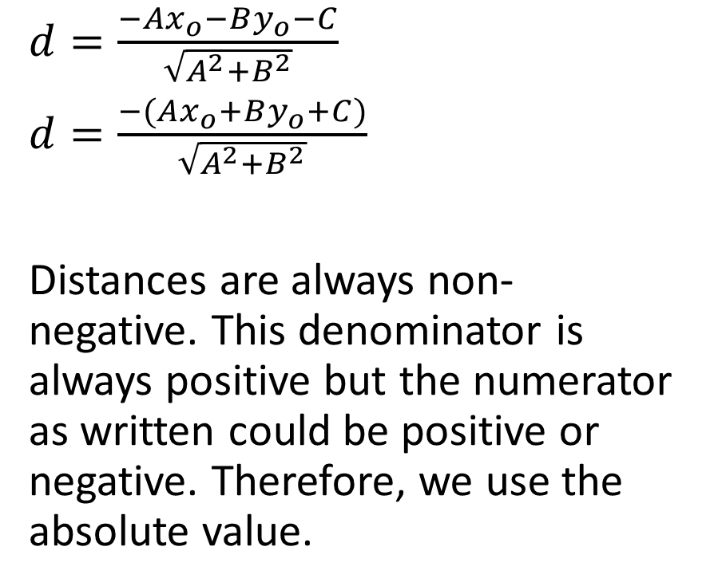
$d=\frac{−Ax_{o}−By_{o}−C}{\sqrt{A^{2}+B^{2}}}$
$d=\frac{−(Ax_{o}+By_{o}+C)}{\sqrt{A^{2}+B^{2}}}$
Distances are always non-negative. This denominator is always positive but the numerator as written could be positive or negative. Therefore, we use the absolute value.
.
. $P_{o}\left(x_{o},y_{o}\right)$
$P_{1}(x_{1},y_{1})$ .
.
R
Ax + By + C = 0
$$\vec{n}=\vec{(A,B)}$$

Slide 19

$d=\frac{ \left|−(Ax_{o}+By_{o}+C)\right| }{\sqrt{A^{2}+B^{2}}}$
.
. $P_{o}\left(x_{o},y_{o}\right)$
$P_{1}(x_{1},y_{1})$ .
.
R
Ax + By + C = 0
$$\vec{n}=\vec{(A,B)}$$

Slide 20

$d=\frac{ \left|−(Ax_{o}+By_{o}+C)\right| }{\sqrt{A^{2}+B^{2}}}$
$d=\frac{ \left|Ax_{o}+By_{o}+C\right| }{\sqrt{A^{2}+B^{2}}}$
.
. $P_{o}\left(x_{o},y_{o}\right)$
$P_{1}(x_{1},y_{1})$ .
.
R
Ax + By + C = 0
$$\vec{n}=\vec{(A,B)}$$

Slide 21
Example
Determine the distance from the point P(-6, 4) to the line with equation 5x-3y+15=0

Slide 22
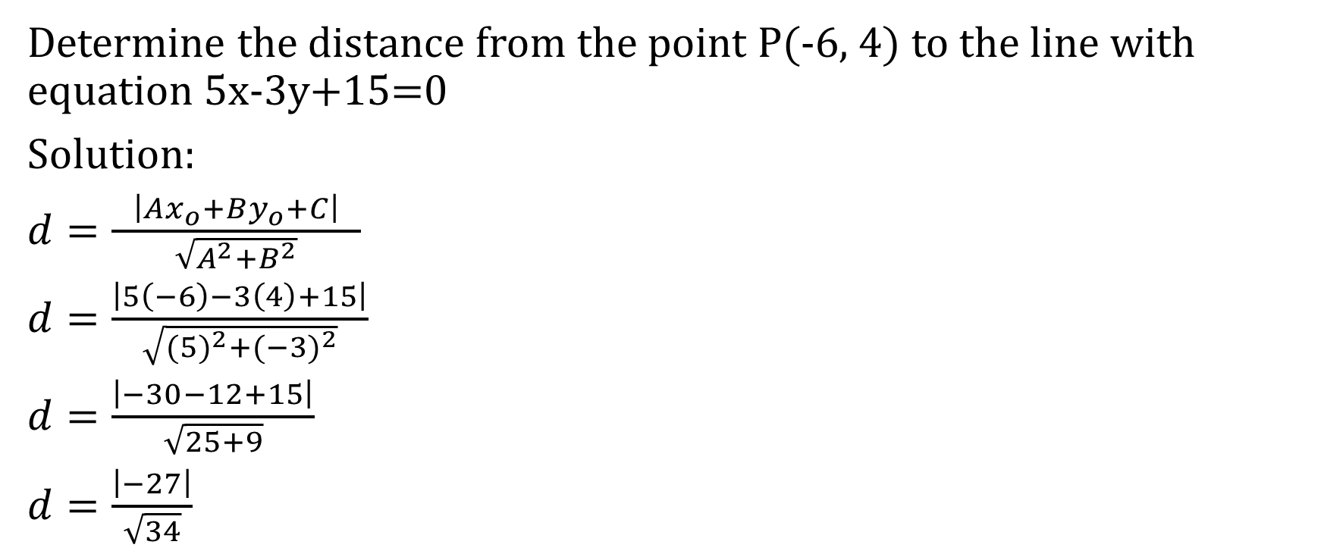
Determine the distance from the point P(-6, 4) to the line with equation 5x-3y+15=0
Solution:
$d=\frac{ \left|Ax_{o}+By_{o}+C\right| }{\sqrt{A^{2}+B^{2}}}$
$d=\frac{\left|5\left(−6\right)−3\left(4\right)+15\right|}{\sqrt{{(5)}^{2}+{(−3)}^{2}}}$
$d=\frac{\left|−30−12+15\right|}{\sqrt{25+9}}$
$d=\frac{\left|−27\right|}{\sqrt{34}}$

Slide 23
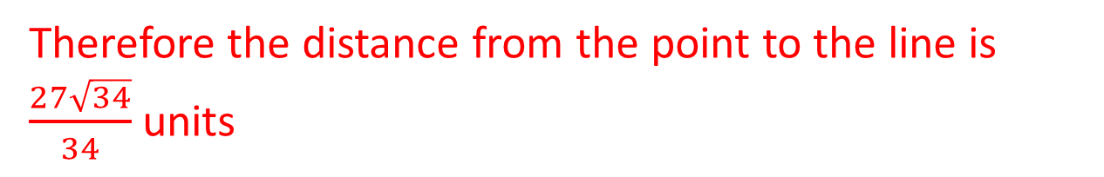

Determine the distance from the point P(-6, 4) to the line with equation 5x-3y+15=0
Solution:
$d=\frac{\left|−27\right|}{\sqrt{34}}$
$d=\frac{27}{\sqrt{34}}$
$d=\frac{27\sqrt{34}}{34}$
Therefore the distance from the point to the line is $\frac{27\sqrt{34}}{34}$ units

Slide 24

Example
Determine the distance from the point P(15,-9) to the line
$\vec{r}=\left(−2,−1\right)+s(−4,3)$

Slide 25
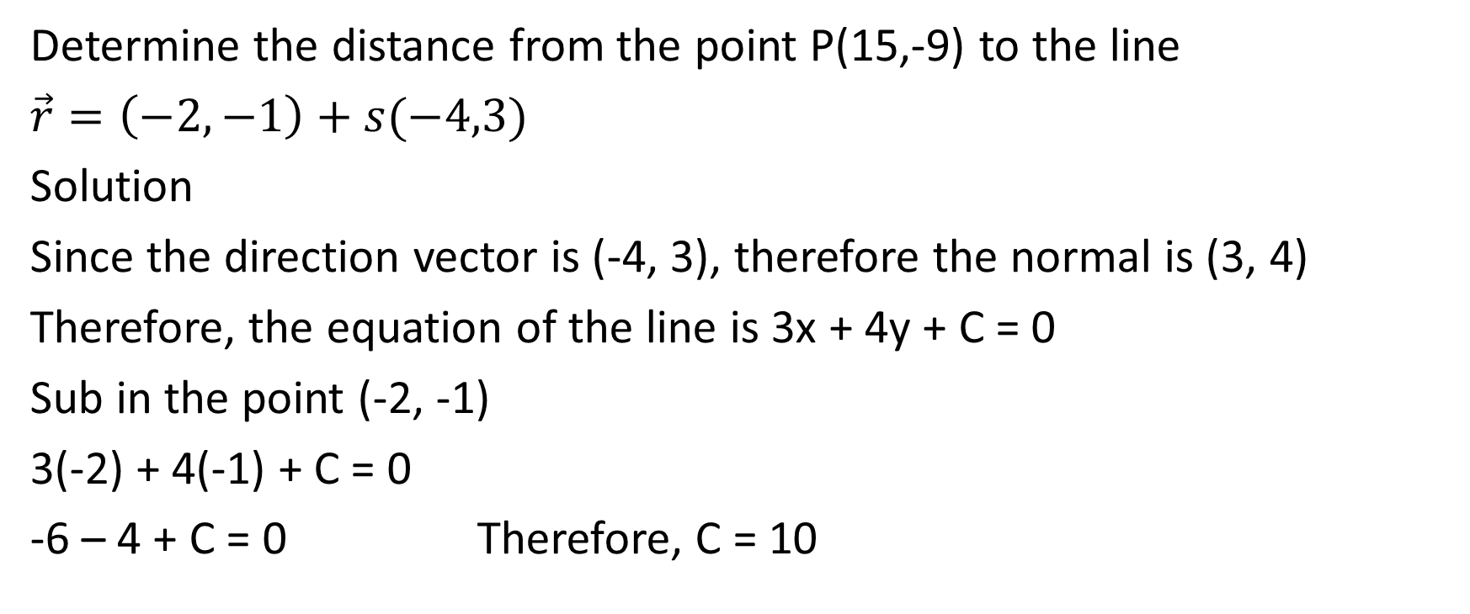
Determine the distance from the point P(15,-9) to the line
$\vec{r}=\left(−2,−1\right)+s(−4,3)$
Solution
Since the direction vector is (-4, 3), therefore the normal is (3, 4)
Therefore, the equation of the line is 3x + 4y + C = 0
Sub in the point (-2, -1)
3(-2) + 4(-1) + C = 0
-6 – 4 + C = 0 Therefore, C = 10

Slide 26
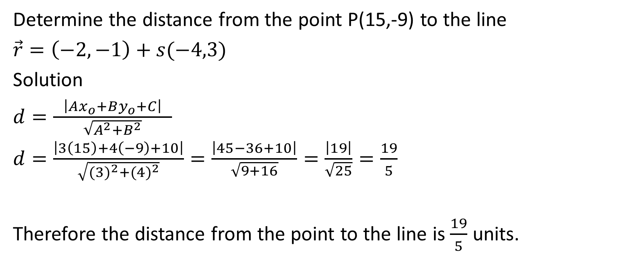
Determine the distance from the point P(15,-9) to the line
$\vec{r}=\left(−2,−1\right)+s(−4,3)$
Solution
$d=\frac{ \left|Ax_{o}+By_{o}+C\right| }{\sqrt{A^{2}+B^{2}}}$
$d=\frac{\left|3\left(15\right)+4\left(−9\right)+10\right|}{\sqrt{{(3)}^{2}+{(4)}^{2}}}=\frac{\left|45−36+10\right|}{\sqrt{9+16}}=\frac{\left|19\right|}{\sqrt{25}}=\frac{19}{5}$
Therefore the distance from the point to the line is $\frac{19}{5}$ units.

Slide 27
Example
Determine the distance between the two parallel lines 5x – 12y + 60 = 0 and 5x – 12y – 60 = 0.

Slide 28
Determine the distance between the two parallel lines 5x – 12y + 60 = 0 and 5x – 12y – 60 = 0.
Solution:
The distance between two parallel lines is equal to the distance between one of the lines and any point on the other line.
Let’s determine a point on line 1,
Let x = 0
5(0) – 12y + 60 = 0
-12y = -60 y = 5 Therefore, (0,5) is on line 1

Slide 29
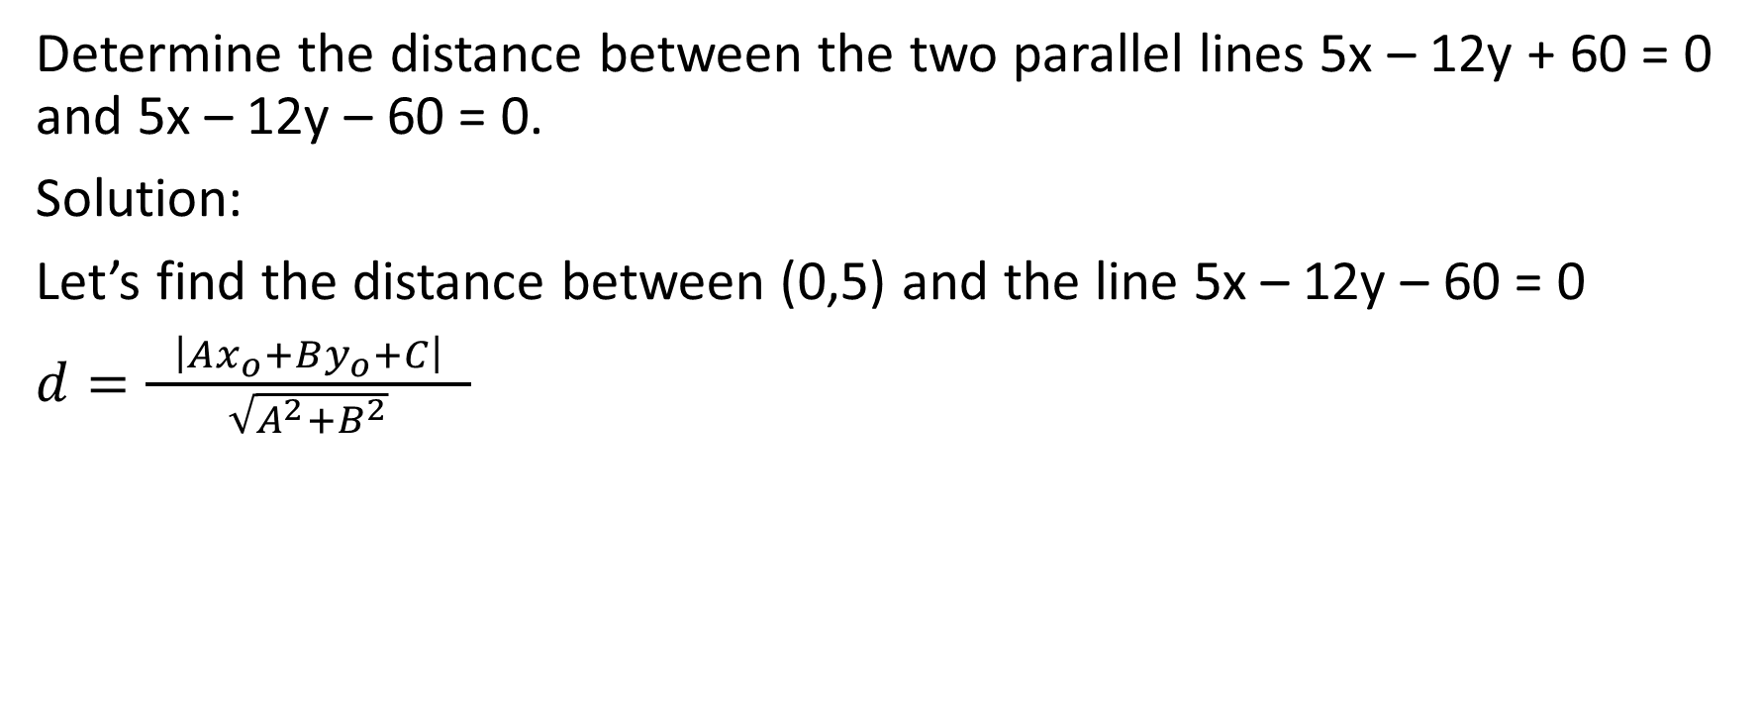
Determine the distance between the two parallel lines 5x – 12y + 60 = 0 and 5x – 12y – 60 = 0.
Solution:
Let’s find the distance between (0,5) and the line 5x – 12y – 60 = 0
$d=\frac{ \left|Ax_{o}+By_{o}+C\right| }{\sqrt{A^{2}+B^{2}}}$

Slide 30
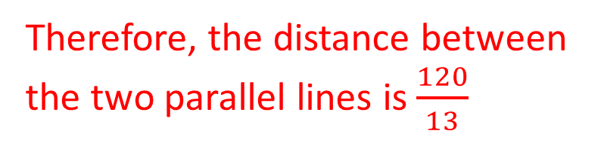
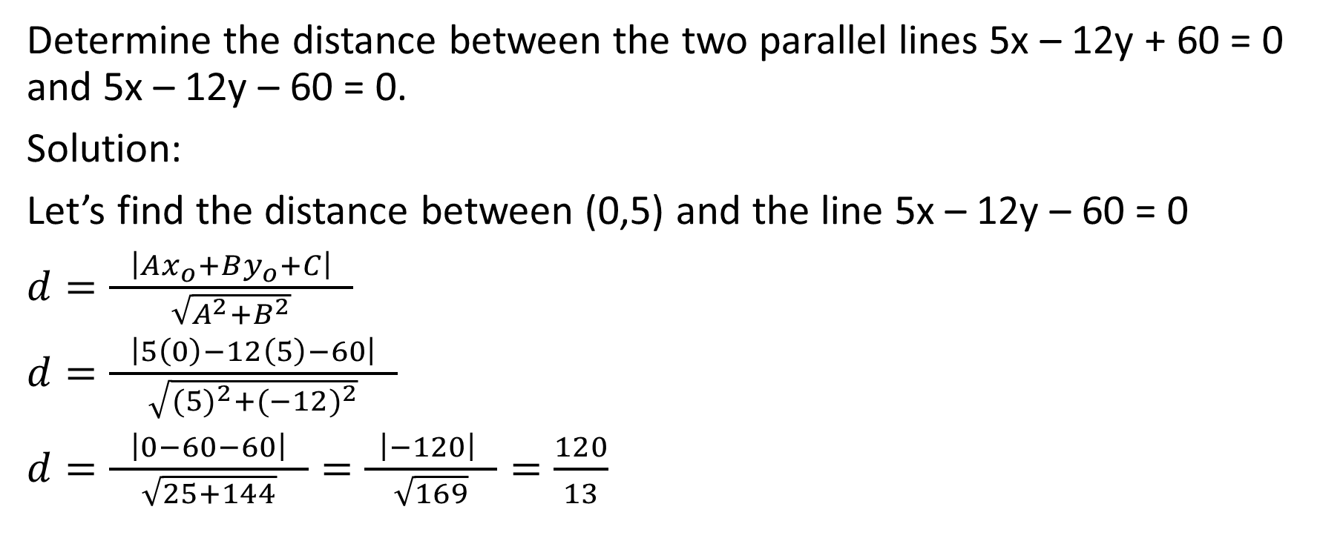
Determine the distance between the two parallel lines 5x – 12y + 60 = 0 and 5x – 12y – 60 = 0.
Solution:
Let’s find the distance between (0,5) and the line 5x – 12y – 60 = 0
$d=\frac{ \left|Ax_{o}+By_{o}+C\right| }{\sqrt{A^{2}+B^{2}}}$
$d=\frac{ \left|5\left(0\right)−12\left(5\right)−60\right| }{\sqrt{{(5)}^{2}+{(−12)}^{2}}}$
$d=\frac{ \left|0−60−60\right| }{\sqrt{25+144}}=\frac{ \left|−120\right| }{\sqrt{169}}=\frac{120}{13}$
Therefore, the distance between the two parallel lines is $\frac{120}{13}$

Slide 31
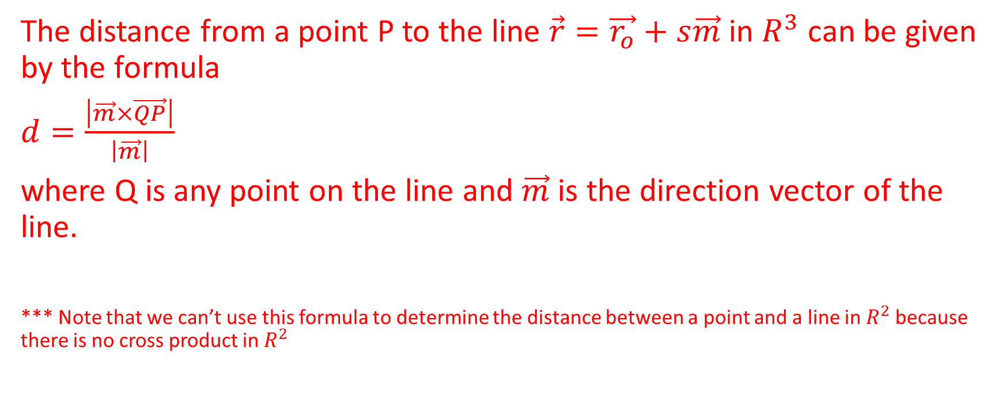

Distance From a Point to a Line in $R^{3}$
The distance from a point P to the line $\vec{r}=\vec{r_{o}}+s\vec{m}$ in $R^{3}$ can be given by the formula
$d=\frac{\left|\vec{m}×\vec{QP}\right|}{\left|\vec{m}\right|}$
where Q is any point on the line and $\vec{m}$ is the direction vector of the line.
*** Note that we can’t use this formula to determine the distance between a point and a line in $R^{2}$ because there is no cross product in $R^{2}$

Slide 32

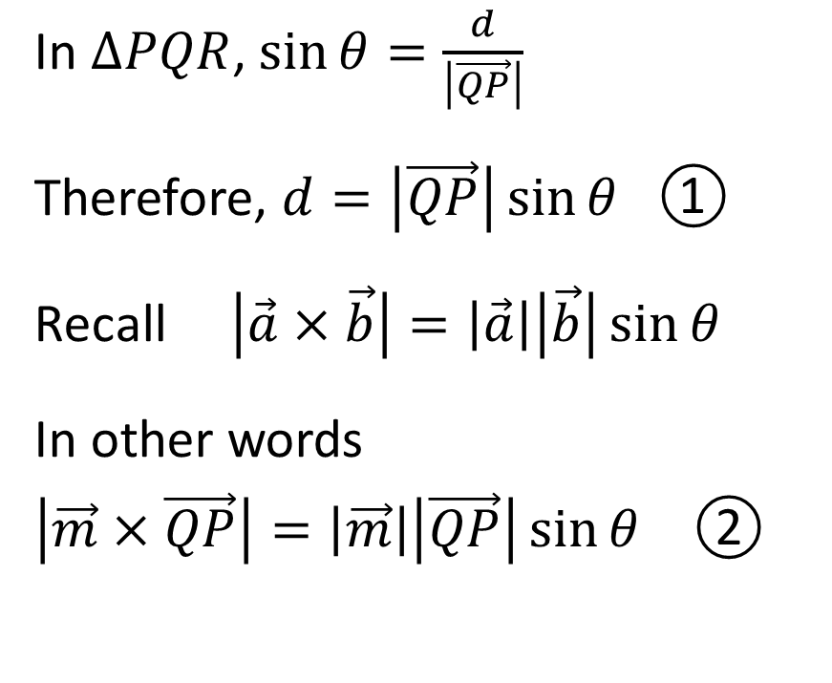

Let’s Derive the Formula we Just Learned
In $∆PQR$, $\sin{θ=\frac{d}{\left|\vec{QP}\right|}}$
Therefore, $d=\left|\vec{QP}\right|\sin{θ}$ ①
Recall $\left|\vec{a}×\vec{b}\right|=\left|\vec{a}\right|\left|\vec{b}\right|\sin{θ}$
In other words
$\left|\vec{m}×\vec{QP}\right|=\left|\vec{m}\right|\left|\vec{QP}\right|\sin{θ}$ ②
.
.
P
.
$\vec{r}=\vec{r_{o}}+s\vec{m}$
R
Q

Slide 33

Therefore, $d=\left|\vec{QP}\right|\sin{θ}$ ①
$\left|\vec{m}×\vec{QP}\right|=\left|\vec{m}\right|\left|\vec{QP}\right|\sin{θ}$ ②
.
.
P
.
$\vec{r}=\vec{r_{o}}+s\vec{m}$
R
Q

Slide 34
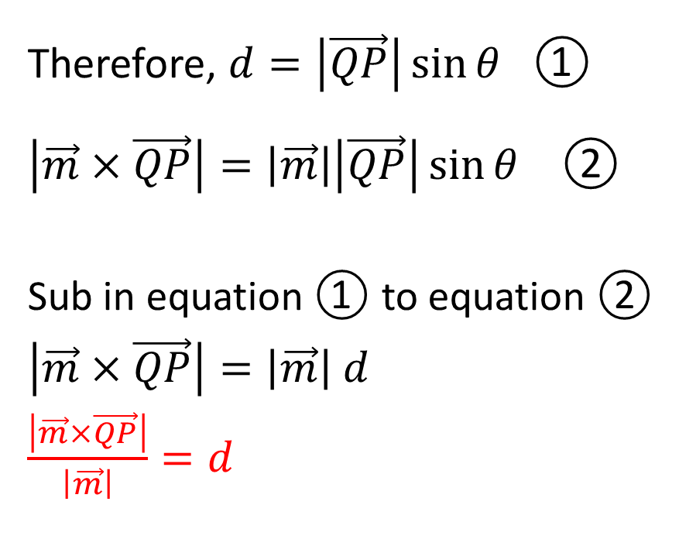
Therefore, $d=\left|\vec{QP}\right|\sin{θ}$ ①
$\left|\vec{m}×\vec{QP}\right|=\left|\vec{m}\right|\left|\vec{QP}\right|\sin{θ}$ ②
Sub in equation ① to equation ②
$\left|\vec{m}×\vec{QP}\right|=\left|\vec{m}\right| d$
$\frac{\left|\vec{m}×\vec{QP}\right|}{\left|\vec{m}\right|}=d$
.
.
P
.
$\vec{r}=\vec{r_{o}}+s\vec{m}$
R
Q

Slide 35

Example
Determine the distance from the point P(-1,1,6) to the line with equation $\vec{r}=\left(1,2,−1\right)+t(0,1,1)$

Slide 36
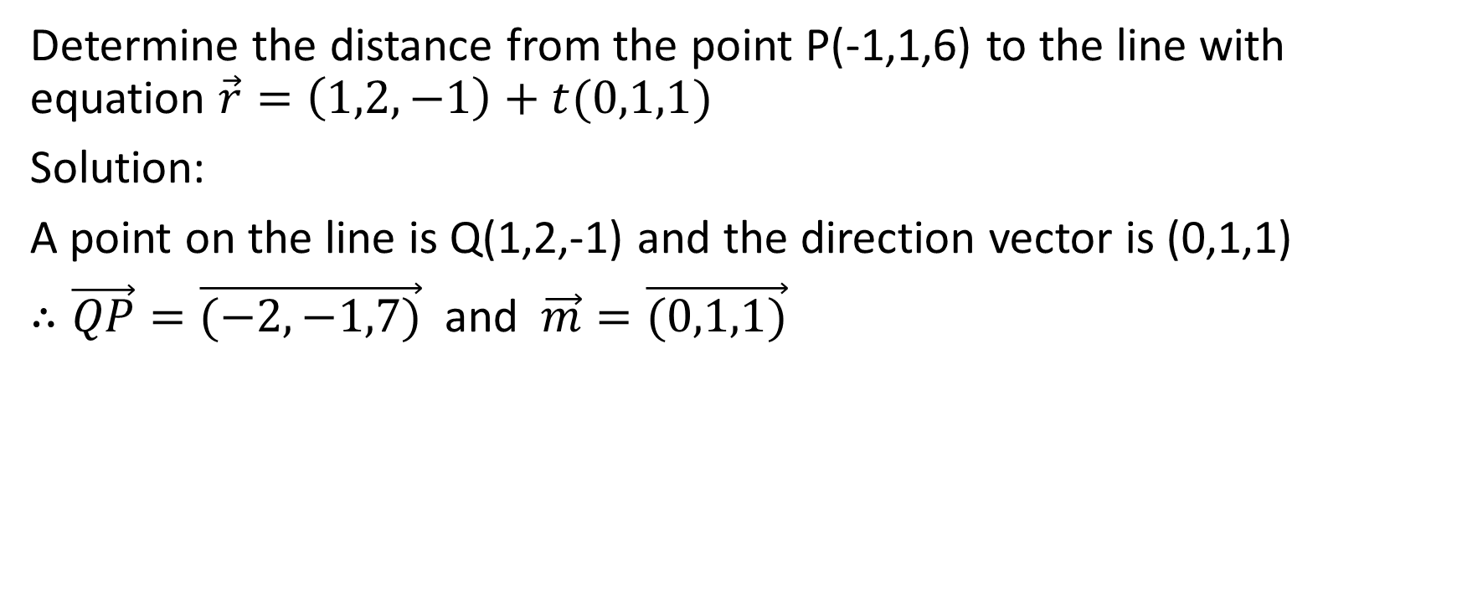

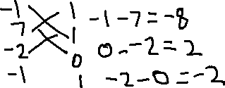



Determine the distance from the point P(-1,1,6) to the line with equation $\vec{r}=\left(1,2,−1\right)+t(0,1,1)$
Solution:
A point on the line is Q(1,2,-1) and the direction vector is (0,1,1)
$∴\vec{QP}=\vec{(−2,−1,7)}$ and $\vec{m}=\vec{(0,1,1)}$

Slide 37
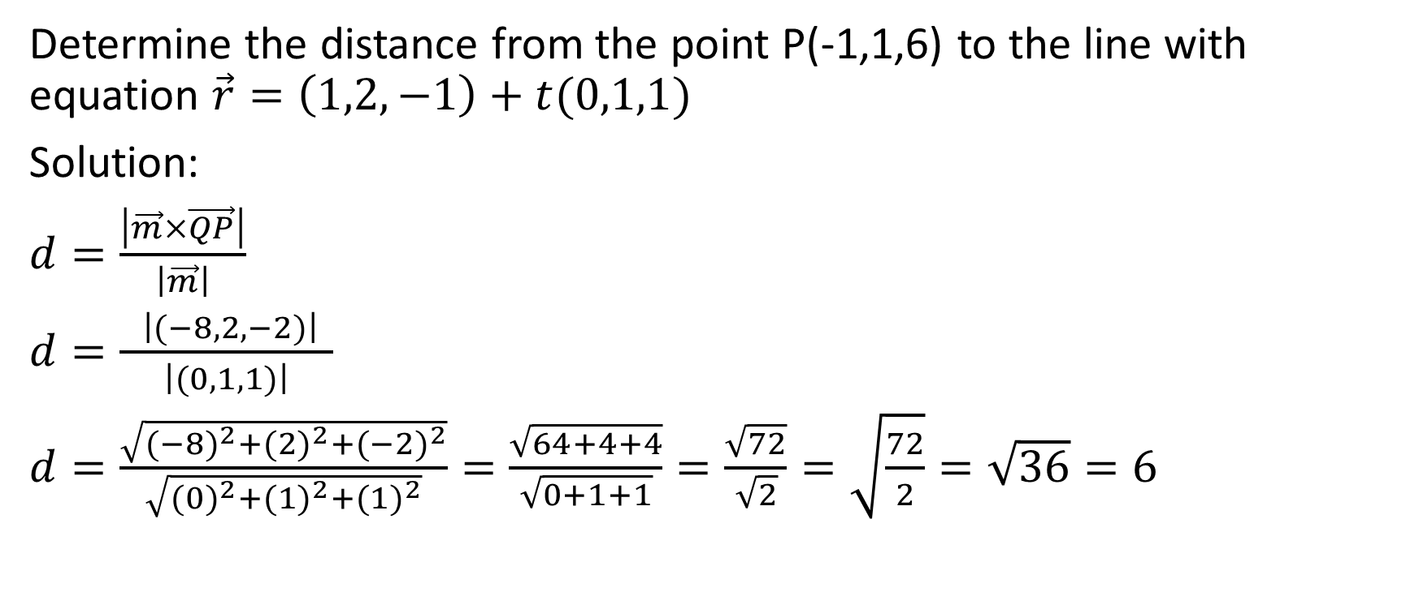
Determine the distance from the point P(-1,1,6) to the line with equation $\vec{r}=\left(1,2,−1\right)+t(0,1,1)$
Solution:
$d=\frac{\left|\vec{m}×\vec{QP}\right|}{\left|\vec{m}\right|}$
$d=\frac{ \left|(−8,2,−2)\right| }{\left|(0,1,1)\right|}$
$d=\frac{\sqrt{{(−8)}^{2}+{(2)}^{2}+{(−2)}^{2}}}{\sqrt{{(0)}^{2}+{(1)}^{2}+{(1)}^{2}}}=\frac{\sqrt{64+4+4}}{\sqrt{0+1+1}}=\frac{\sqrt{72}}{\sqrt{2}}=\sqrt{\frac{72}{2}}=\sqrt{36}=6$

Slide 38
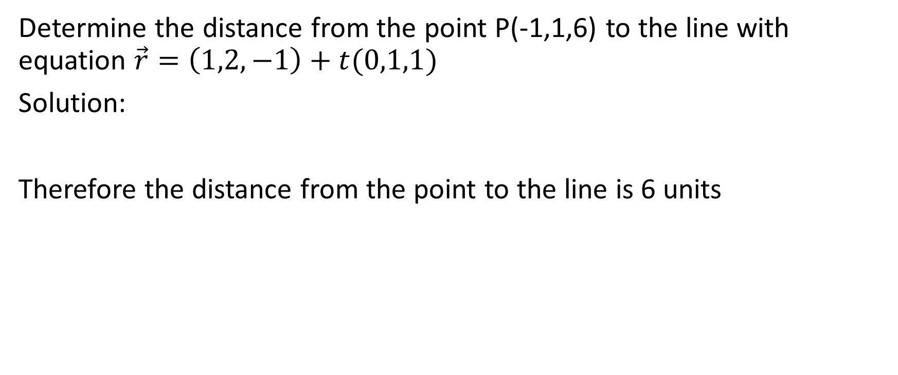
Determine the distance from the point P(-1,1,6) to the line with equation $\vec{r}=\left(1,2,−1\right)+t(0,1,1)$
Solution:
Therefore the distance from the point to the line is 6 units

